Slide 1



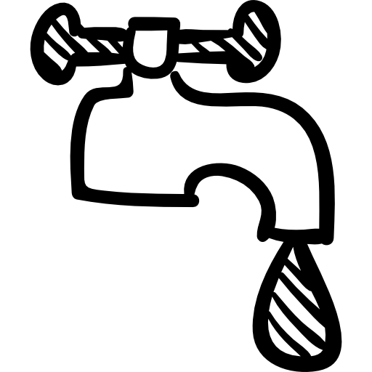

Dripping taps?
Water that goes down the drain is treated and released back to the waterways, which takes energy, chemicals and biological processes.
A tap that drips once per second sends around 5 litres of water a day down the drain unneccesarily!
Ensure you report dripping taps and overflowing cisterns by [enter information here]
Green Impact is run by colleagues in your department. If you’d like to help, contact [enter contact details here]
Get Involved!

