Slide 1
Introduction to Green Impact

Slide 2
GREEN IMPACT: HOW DOES IT WORK?

Slide 3
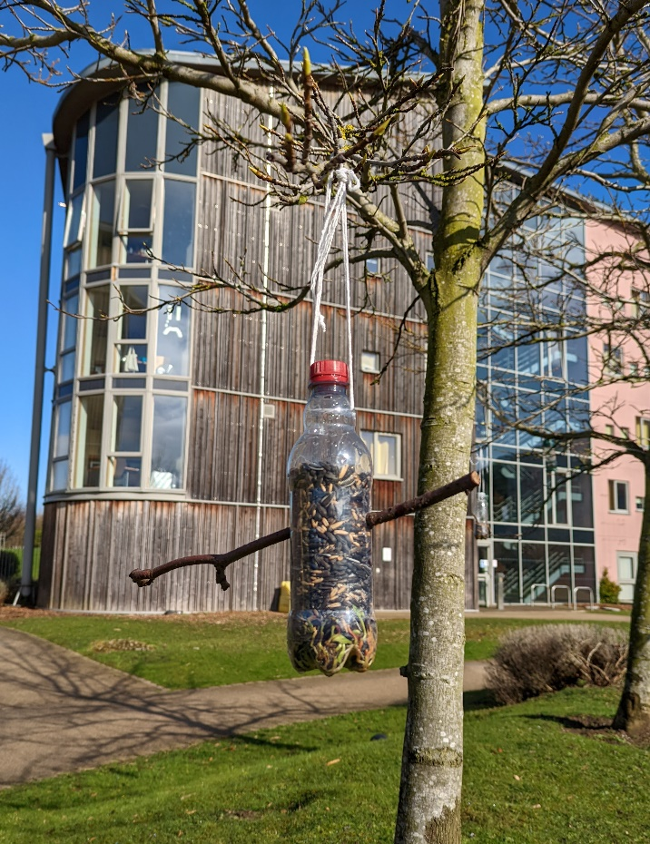
Green Impact: an overview
Large organisations have large environmental and social impacts, both positive and negative.
Infrastructure and policy changes can only make some of the difference: changing behaviours and attitudes of our people is crucial.
Green Impact offers a framework and support to tackle sustainability issues within your team and recognises you for making an impact.
You implement a set of positive sustainability activities, using our online toolkit to guide you and track your progress.
A student auditor will go through all your work with you at the end of the year and verify your award level.

Slide 4
Green Impact: an overview
There are different themes within the online toolkit that cover different areas of sustainability.
You can work through the actions in any order based on your sustainability priorities and the nature of your team.
The actions are designed to meaningfully support the sustainability of your team, the organisation, and the wider community .
Social
Environmental
Economic

Slide 5
Project cycle

Slide 6
Getting your award
You can get a Bronze, Silver, Gold award, based on the impact and effort of your Green Impact activities.
Bronze - Score at least 100 points on the online toolkit;
Silver – Score at least 200 points on the online toolkit;
Gold – Score at least 300 points on the online toolkit.
Notes:
Update with your scoring system

Slide 7
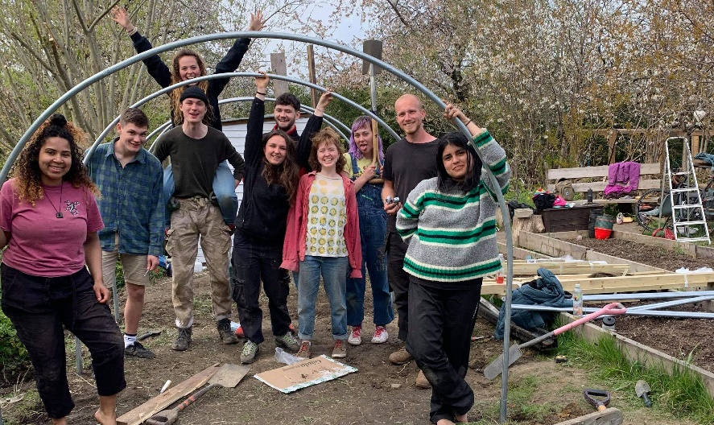
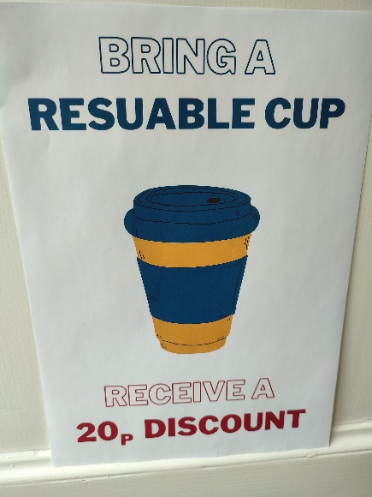
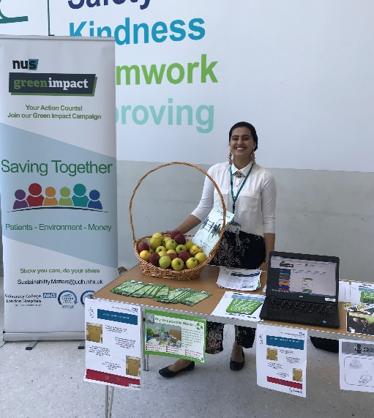
Why should you take part?
Supporting the organisation’s sustainability strategy
Personal and professional development
Learn more about sustainability issues
Get recognised with a Green Impact award
Potential to save money and resources
Network and share ideas with others inside and outside of your team
Responding to student/patient/public demand and improving reputation
Encourage colleagues to think about sustainability in new and innovative ways
Make an impact!

Slide 8
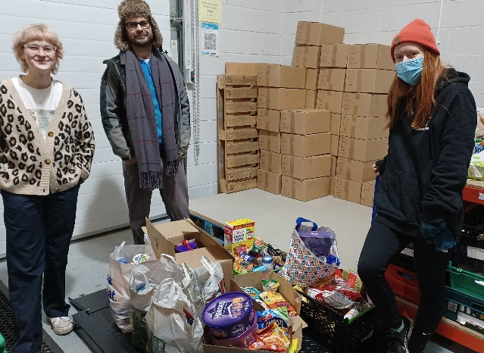
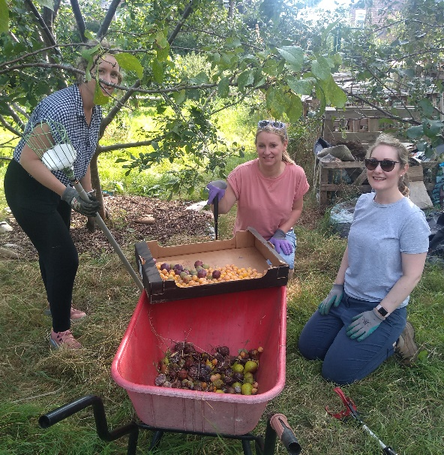
How do I get started?
Register your team on the Green Impact toolkit (or you can join an existing team if one is already set up): www.greenimpact.uk/X
Gather interest from your colleagues – as many people as you like can register online and join your team to support you.
We’ll be in touch with support and guidance throughout the year – keep an eye out for communications from us!
You’ll have until SUBMISSION DEADLINE DATE to complete as many actions as you can, and we’ll send reminders closer to the submission date with information on audits and awards.

Slide 9
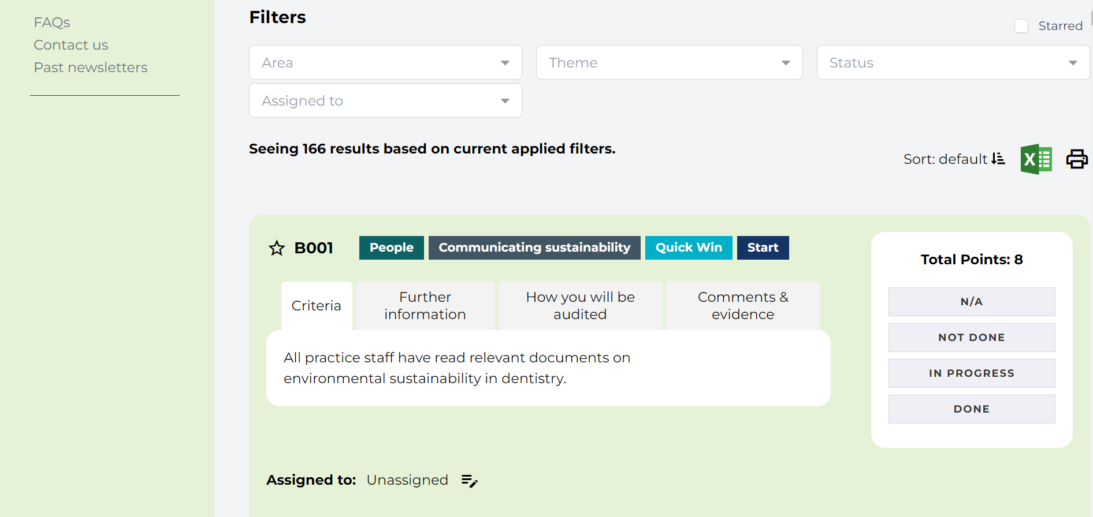
How the toolkit works
Any colleague who joins your team will view the same toolkit and be able to see your team’s progress, meaning you can all collaborate and delegate the actions within the toolkit.
Find the actions most relevant to you using the filters at the top of the page.

Slide 10
INTERNATIONAL IMPACT AND CONTEXT

Slide 11
Green Impact in numbers: Help us make the programme bigger and better by registering your team and joining the global movement!
Green Impact has been delivered in 7 countries globally
The programme has been running successfully for 15 years
Green Impact has run in 1,197 organisations ranging from students’ unions to NHS Trusts
116 Universities and Colleges have used the Green Impact model
7,857 Green Impact teams have formed across participating organisations
45,000 people have actively been part of Green Impact teams
Green Impact teams have reached 375,000 people with sustainability and social justice activities
7,700 students have been provided with training and development opportunities
560,000 actions completed by teams and verified by student auditors
340,000 of these completed actions are as a direct result of the programme
More than 1,000 learning workshops delivered with students and staff
£7.3 million saved in participating organisations (estimated from available data)
26,500 tonnes CO₂ saved (estimated from available data)

Slide 12
Thank you!
Together we can make a massive combined impact!

